Slide 1
Kramer-Kronig analysis
Step-by-step guide

Slide 2
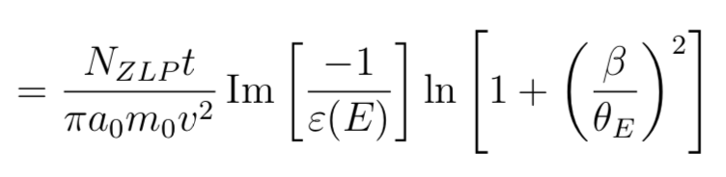
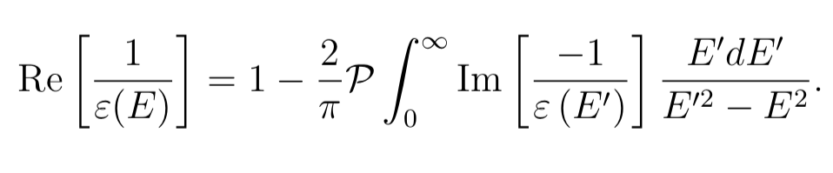

Starting point:
Single scattering distribution of bulk excitations in terms of dielectric function:
Kramer-Kronig relations:
\cite{Egerton_book}
\cite{dapor2017}

Slide 3
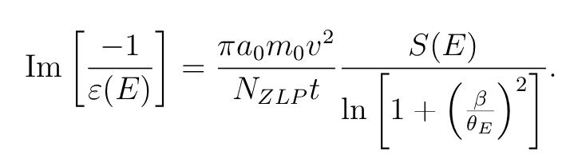
Extracting Im[-1/ε]
?
KNOWN

Slide 4
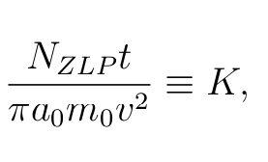
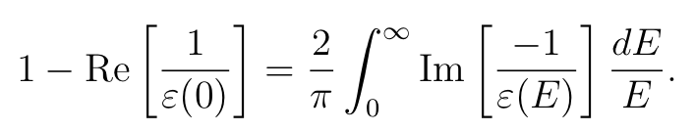
Finding K
Take E = 0 in
Gives

Slide 5
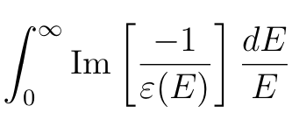


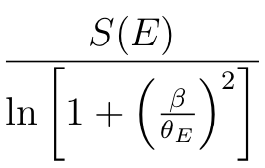
Finding K
Dividing by E and integrating both sides of
Gives

Slide 6

Finding K
Combining
Gives
&
KNOWN
ALSO KNOWN for many materials

Slide 7
Can extract Im[-1/ ε]!
FOUND!
KNOWN

Slide 8
Finding Re[1/ε]
Use:
But: for discrete spectrum: singularity at E = E’
→ use causality dielectric function

Slide 9



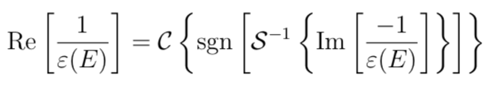
Finding Re[1/ε]
Using:
And, due to causality:
Resulting in:

Slide 10
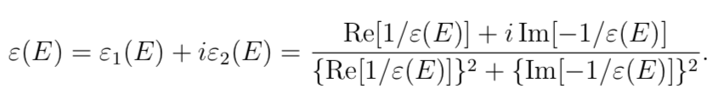
Finding dielectric function
Yippy!!

Slide 11
Cool cool cool, BUT
Assumed single scattering S(E) distribution of bulk excitations to be know…
In reality the recorded spectrum consists of bulk excitations, surface excitations and relativistic losses.

Slide 12
Obtaining S_{b}(E)
S_{b}(E) obtainable from bulk excitations through Fourier log deconvolution method
→ need to obtain bulk excitations from total spectrum

Slide 13
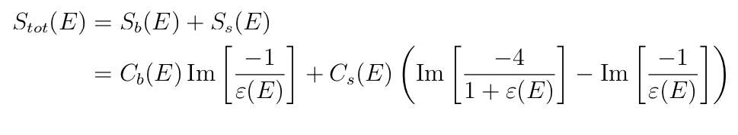
Obtaining S_{b}(E)
Assume no relativistic losses:
Difficult to extract ε from this function
\cite{thesis_ascunce}

Slide 14

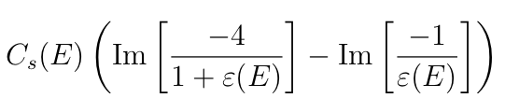





Plan of attack
Assume:
Calculate ε’ with KK-analysis
Calculate
Better approximation:
Calculate ε’’ with KK-analysis
Calculate S_{s}’’
Approximate S_{b}’’’
Calculate ε’’’ with KK-analysis
Calculate S_{s}’’’
Approximate S_{b}’’’’
Repeat until convergence

Slide 15

Including relativistic losses
Kröger function:
Similar approach probably

Slide 16
What is the dielectric function?
Description of reaction of the entire solid to the passing electron:
Real part: permittivity, polarizability
Imaginary part: energy dissipation

Slide 17
Interpretations of the dielectric function
Real part:
Crosses zero: transitions in the system (plasmons, interband, …)
Number of crosses: character of material (metallic, semi-conductor, …)
Imaginary part:
Damping on transitions

Slide 18

High energy range
ε₁ → 1, ε₂ small

Slide 19

Crossings with +slope ε₁
Well defined collective response (i.e. peak/transition?)
Condittion for plasma resonance

Slide 20

Cherenkov radiation
When:

Slide 25
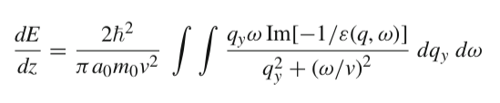
Damping
Stopping power:

Slide 26
Low loss electron energy spectrum

Slide 27

Insert a picture

Slide 28
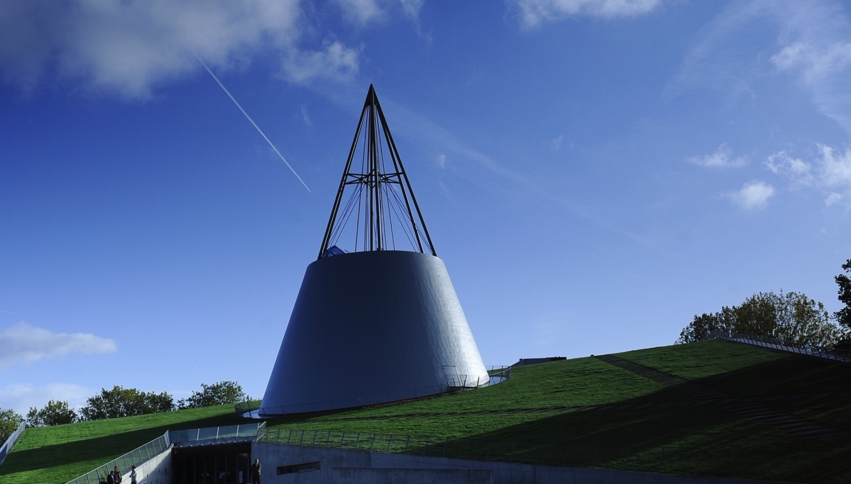
Insert a picture

